Slide 1
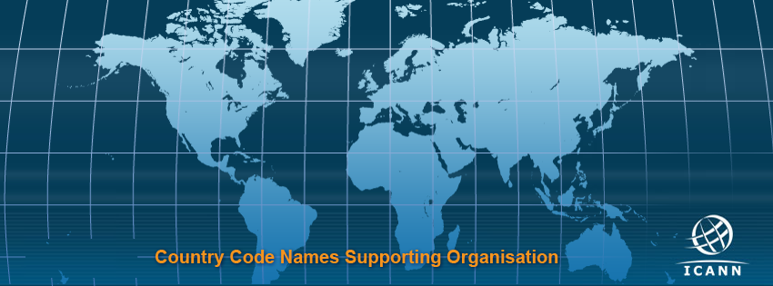
One Size Does Not Fit All
GAC-ccNSO meeting
26 June 2018, Panama

Slide 2
TLDs

Slide 3
TLDs
ccTLDs
gTLDs

Slide 4
ccTLDs: General Info
Country code Top Level Domains
Country code list – ISO 3166-1
Local management and operation
Serve Local Internet Community
Own policy
Local solution disputes, UDRP - optional
Technical competency
Notes:
A Country Code Top-Level Domain (ccTLD) is a two-letter Internet top-level domains (TLDs) specifically designated for a particular country, sovereign state or autonomous territory for use to service their community. ccTLDs are derived from ISO 3166-1 alpha-2 country codes.[

Slide 5
ccTLDs: Governance
Legal Structure – mostly not-for-profit
Registration models:
Registry-Registrar model
Direct registrations
Mixed model
Management models:
Combined policy and registration
Separated policy and registration
Outsourced registration function

Slide 6
ccTLDs: Policy
Local policy reflect:
local legal structure and laws,
local public policy
local Custom
Example: WHOIS defined locally

Slide 7
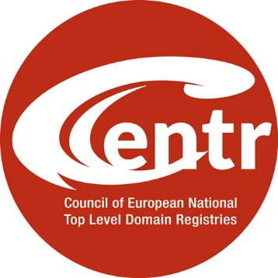
Regional ccTLD organisations
Formed by the ccTLD registries

Slide 8
ccNSO -
Voluntary organisation for ccTLDs
165 members (June 2018)
5
44
52
27
37
Observers: AfTLD, APTLD, CENTR, LACTLD

Slide 9
What do the ccNSO members do?
Elect the Council
Select 2 ICANN Board members
Vote on policies and Council resolutions
Participate in WGs
Suggest topics, set Meeting agenda

Slide 10
ccNSO Council
3
3
+
+
+
+
3
3
3
+
3 (by NomCom)
+
4 (observers from ROs)

Slide 11
What does
the ccNSO Council do?
Administrative role
Representative role

Slide 12
ccTLDs and ICANN
IANA function
ccNSO membership
Financial contributions
Documentation of relationship
Notes:
All
148
70+
50+

Slide 13
Thank you!
Questions?

